Slide 1
CIT 6101: REVIEW OF LITERATURE
Chapter Two
D
Y
E
G
D
AN
O
IV T
L
Dr. Jane.Kuria
K
IM
AT
HI
UN
ERSI
Y O
F T
EC
H
NO
Dedan Kimathi University of Technology

Slide 2
Learning Outcomes
Explain what is a research topic
Describe the purpose of the literature review.
Distinguish how to conduct literature review in qualitative, quantitative and mixed methods.
Explain the design techniques for conducting literature review.
Explain how to define terms in literature review.

Slide 3
Review of the Literature
Determines whether the topic is worth studying
It provides insight into ways in which the researcher can limit the scope to a needed area of inquiry.

Slide 4
Research Topic
Topic is the subject or subject matter of a proposed study, the central idea to learn about or to explore.
Create a working draft/working title e.g. My study is about. . . .”
complex and erudite language.
Wilkinson (1991) provides useful advice for creating a title: Be brief and avoid wasting word. No longer than 12 words
Pose the topic as a brief question
Actively elevating this topic to a research study calls for reflecting on whether the topic can and should be researched

Slide 5
Why research a topic?
Adds to the pool of research knowledge available on the topic
Replicates past studies
Lifts up the voices of underrepresented groups individual
Helps address social justice
Transforms the ideas and beliefs of the researcher.

Slide 6
Topics should..
Appeal to a larger audiences
Researcher’s personal goals.
Weigh factors
Ask others for their reaction to a topic under consideration

Slide 7
The Literature Review
The purpose of the lite review;
It shares with the reader the results of other studies that are closely related to the one being undertaken.
It relates a study to the larger, ongoing dialogue in the literature, filling in gaps and extending prior.
It provides a framework for establishing the importance of the study as well as a benchmark for comparing the results with other findings

Slide 8
Use of the Literature
Literature review in a proposal be brief and summarize the major literature on the research problem.
Develop a detailed outline of the topics and potential references that will later be developed into an entire chapter.
In journal articles it is abbreviated “related literature”.

Slide 9
Literature review in Qualitative research
Literature provides a useful backdrop for the problem or issue that has led to the;
need for the study,
who has been writing about it
who has studied it
who has indicated the importance of studying the issue.
Review the literature in a separate section, a model typically used in quantitative research, often found in journals with a quantitative orientation.
The researcher may incorporate the related literature in the final section, where it is used to compare and contrast with the results (or themes or categories) to emerge from the study

Slide 10
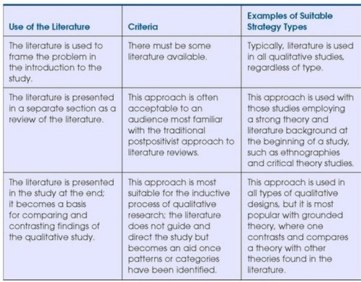
Using Literature in a Qualitative Study

Slide 11
Literature review in quantitative research
Includes a substantial amount of literature at the beginning of a study to provide direction for the research questions or hypotheses.
The literature review can introduce a theory—an explanation for expected relationships.
In the end of a study, the literature is revisited by the researcher, and a comparison is made between the results with the existing findings in the literature.
Researcher uses the literature deductively as a framework for the research questions or hypotheses

Slide 12
Cooper 1994
He suggest literature review can be
Integrative review: summarize broad themes in the literature,
Theoretical review: researcher focuses on extant theory that relates to the problem under study.
Methodological review: he researcher focuses on methods and definitions.
These reviews may provide both a summary of studies and a critique of the strengths and weaknesses of the methods sections.

Slide 13
Literature review in mixed methods study
The researcher uses either a qualitative or a quantitative approach to the literature, depending on the type of strategy being used.
Literature use in a mixed methods project will depend on the strategy
The relative weight given to the qualitative or quantitative research in the study.

Slide 14
Design techniques in conducting lite review
Steps in Conducting a Literature Review
Find key words
Go to library and find material based on the key words
Set a priority on the search for journal articles and books, about 50 of them.
Skim through the article and identify the important ones.
Design a literature map
Struct it thematically or organize it by important concepts

Slide 15
Research tips for searching computer databases
Use both the free, online literature databases as well as those available through your academic library..
Search several databases, even if you feel that your topic is not strictly education.
Use guides to terms to locate your articles, such as a thesaurus.
Locate an article that is close to your topic.
Use databases that provide access to full-text copies of your articles

Slide 16
Priority for selecting literature material
For new topics start with the broad synthesis and abstract of journal articles.
Turn to journal articles in respected, national journals, especially those that report research studies.
Turn to books related to the topic. Begin with research monographs that summarize the scholarly literature.
Follow this search by recent conference papers.
Scan the entries in dissertation Abstracts
The Web also provides helpful materials for a literature review.

Slide 17
A Literature Map of the Research
This map is a visual summary of the research that has been conducted by others, and is usually a figure.
It could be
hierarchical structure, with a top-down presentation of the literature ending with the proposed research.
similar to a flowchart in which the reader understands the literature as unfolding from left to right with the farthest right-hand section advancing a proposed study.
A third model might be a series of circles, with each circle representing a body of literature and the intersection of the circles the place in which the future research is indicated.

Slide 18
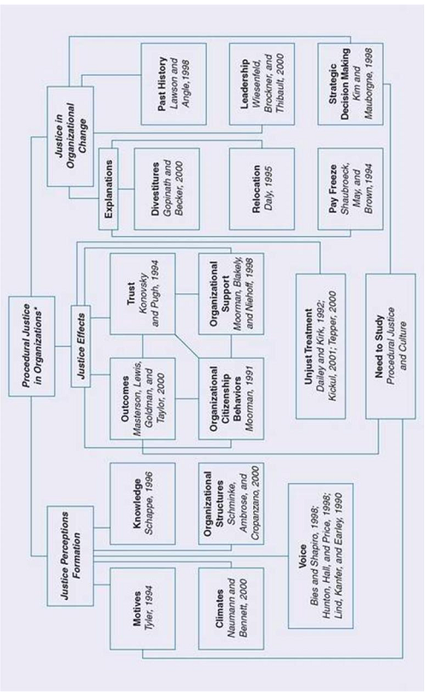
Literature Map ’Employees’ concerns about the fairness of managerial decisions

Slide 19
Abstracting Studies
An abstract is a brief review of the literature (typically in a short paragraph) that summarizes major elements, to enable a reader to understand the basic features of the article.
Mention the problem being addressed.
State the central purpose or focus of the study.
Briefly state information about the sample, population, or subjects.
Review key results that relate to the proposed study.
If it is a methodological review (Cooper, 1984), point out technical and methodological flaws in the study.

Slide 20
Style Manuals
Style manuals provide guidelines for creating a scholarly style of a manuscript such as;
a consistent format for citing references
Creating headings
presenting tables and figures
using nondiscriminatory language
The most important style considerations involve in-text, end-of-text references, heading, footnotes and figures and tables use.

Slide 21
The Definition of Terms
Define terms when
Individuals outside the field of study may not understand and that go beyond common language
they first appear so that a reader does not read ahead in the proposal operating with one set of definitions different from author
it adds precision to a scientific study
The terms to be defined he title of the study, problem statement, purpose statement, research questions, hypotheses, or objectives, literature review, theory base of the study and methods section.

Slide 22
Defining terms-qualitative studies
Define few terms at the beginning.
Authors define these terms in the procedure section as they surface during the process of research.
Qualitative proposals often do not include separate sections for definition of terms.
Writers pose tentative, qualitative definitions before their entry into the field.

Slide 23
Definition of terms: Quantitative studies
Include extensive definitions early in the research proposal
Investigators place them in separate sections and precisely define them.
The researchers try to comprehensively define all relevant terms at the beginning of studies.
uses accepted definitions found in the literature.

Slide 24
Definition of terms: Mixed Methods
Definitions might include a separate section if the study begins with a first phase of quantitative data collection.
If it begins with qualitative data collection, then the terms may emerge during the research, and they are defined in the findings.
Clarify terms related to the strategy of inquiry used, such as concurrent tor sequential, and the specific name for it.

Slide 25
Approach to defining terms (Locke et al., 2007)
Define a term when it first appears in the proposal.
Write definitions at a specific operational or applied level.
Do not define the terms in everyday language; instead, use accepted language available in the research literature.
Researchers might define terms so that they accomplish different goals e.g. a limitation.
one approach is to develop a separate section, called the “Definition of Terms,” and clearly set off the terms and their definitions by highlighting the term.

Slide 26
A Quantitative or Mixed Methods Literature Review
Introduce the review by telling the reader about the sections included it. This passage is a statement about the organization.
Review Topic 1, which addresses the scholarly literature about the independent variable or variables.
Review Topic 3, which includes the scholarly literature that relates the independent variable(s) to the dependent variable(s).
Review Topic 3, which includes the scholarly literature that relates the independent variable(s) to the dependent variable(s).
Provide a summary that highlights the most important studies, captures major themes, suggests why more research is needed on the topic, and advances how the proposed study will fill this need.

Slide 27



THANK YOU
Dr Jane Kuria
Telephone: +254-721 709511 Email: jane.kuria@dkut.ac.ke
D
Y
E
G
D
AN
O
IV T
L
K
IM
AT
HI
UN
ERSI
Y O
F T
EC
H
NO
Dedan Kimathi University of Technology

